Slide 1


Design Patterns
Wieger Wesselink, j.w.wesselink@tue.nl
Joris Geurts, j.geurts@fontys.nl

Slide 2
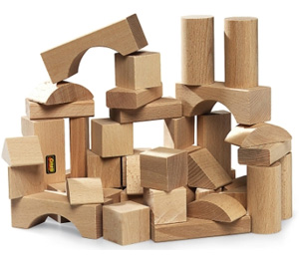
What is a design pattern?
A design pattern is a general reusable solution to a commonly occurring problem in software design.

Slide 3
Design Patterns (recap)
Addressing the following problems:
reusability
maintainability
extensibility

Slide 4
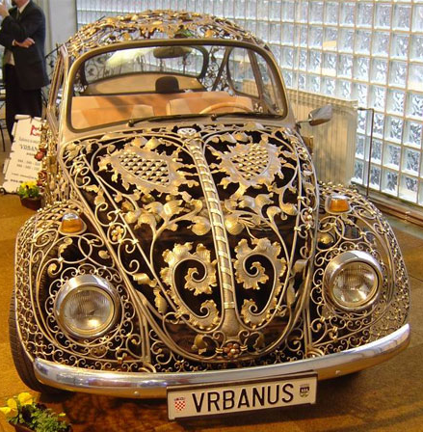
Decorator Pattern
Attach additional responsibilities to an object dynamically, keeping the same interface.
Decorators provide a flexible alternative to subclassing for extending functionality.

Slide 5
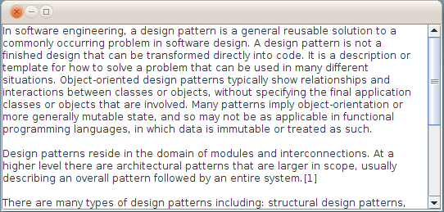
Example
Text area with border and scroll bar

Slide 6
Different approaches
Add responsibilities to the object using inheritance (inflexible).
Enclose the object in another object (called decorator) that adds the additional responsibility.

Slide 7

Example problem
Design a class framework for selling different types of coffee.
Each drink can optionally have condiments like milk, soy, whip etc.

Slide 8
Beverages
abstract class Beverage
{
double cost();
}
class HouseBlend extends Beverage
{
double cost() { return (1.99); }
}
class Espresso extends Beverage
{
double cost() { return (2.29); }
}

Slide 9
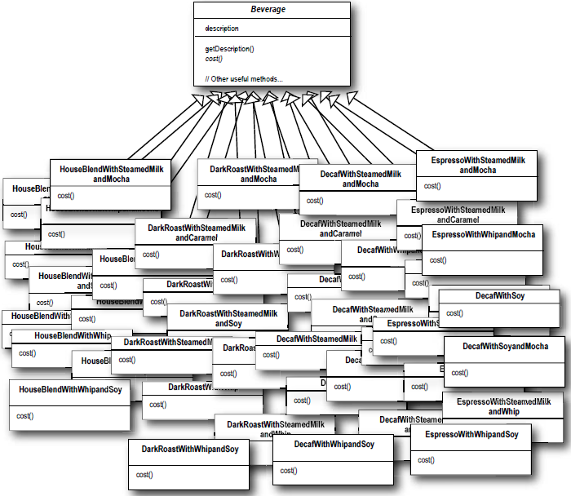
Solution 1: inheritance
abstract class Beverage
{
double cost();
}
class HouseBlendWithMilkAndWhip extends Beverage
{
double cost()
{
return (1.99 + milkCost + whipCost);
}
}
class EspressoWithWhip extends Beverage
{
double cost()
{
return (2.29 + whipCost);
}
}
class explosion!

Slide 10
Solution 2: instance variables
abstract class Beverage
{
boolean hasMilk;
boolean hasSoy;
boolean hasWhip;
String getDescription();
double cost()
{ // returns condiment cost
double cost = 0.0;
if (hasMilk) cost += milkCost;
...
return (cost);
}
}
class HouseBlend extends Beverage
{
double cost() { return (1.99 + super.cost()); }
}

Slide 11
Discussion
Future changes have impact on existing classes:
  Price changes
  Adding new condiments
  Adding new beverages with incompatible condiments

Slide 12
Design principle
Classes should be open for extension, but closed for modification.
Allow changes without modifying existing classes.

Slide 13
Solution 3: decorator (final)
interface Beverage
{
double cost();
}
class HouseBlend implements Beverage
{
double cost() { return (1.99); }
}
abstract class CondimentDecorator implements Beverage
{
Beverage beverage;
}
class Whip extends CondimentDecorator
{
Whip(Beverage b) { beverage = b; }
double cost() { return (0.20 + beverage.cost()); }
}
Beverage b = new Espresso();
Beverage b2 = new Whip(b);
Beverage b3 = new Soy(b2);
b3.cost();

Slide 14
Solution 3: decorator illustrated
Beverage b = new Espresso();
Beverage b2 = new Whip(b);
Beverage b3 = new Soy(b2);
b3.cost();
Soy
cost() {
return 0.2 + b2.cost();
}
return 0.2 + 2.79;
Whip
cost() {
return 0.5 + b.cost();
}
return 0.5 + 2.29;
Espresso
cost() {
return 2.29;
}

Slide 15
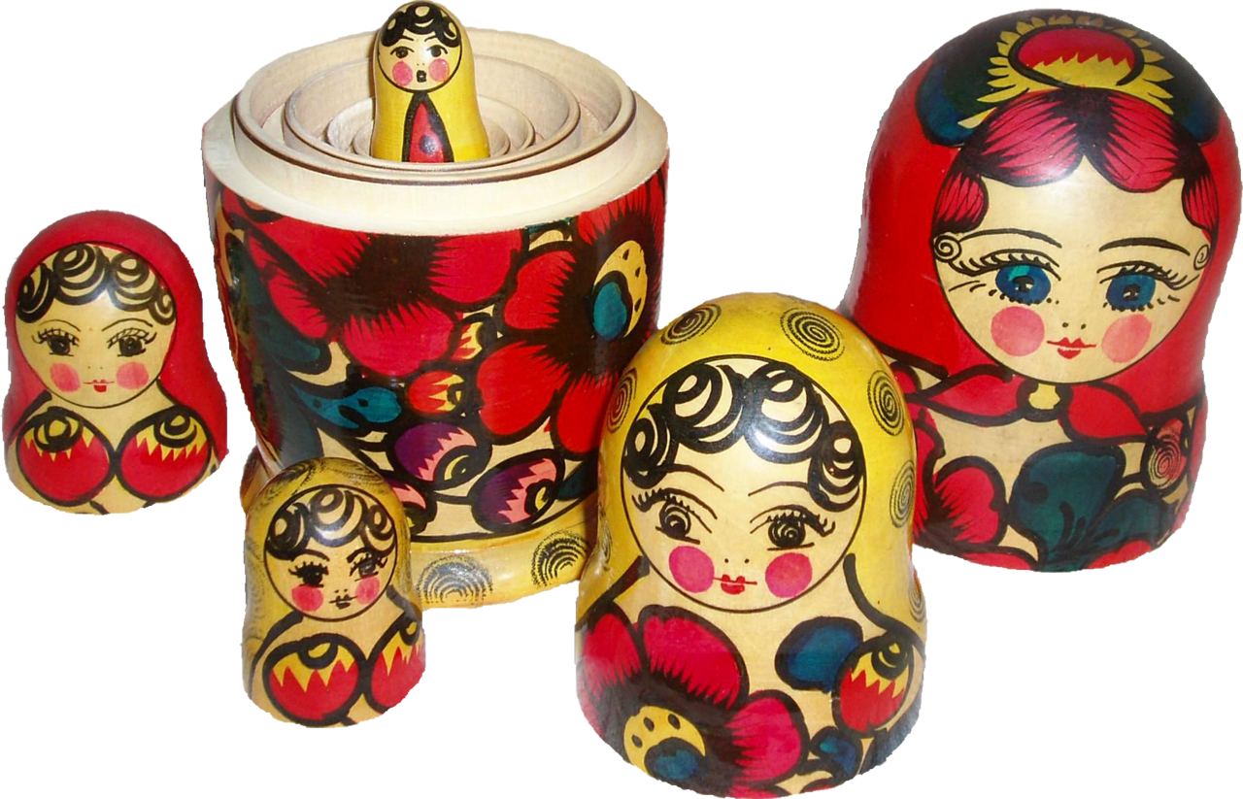

Slide 16

Discussion
Decorator wraps an object to add behavior
Decorator has the same interface as the wrapped object

Slide 17
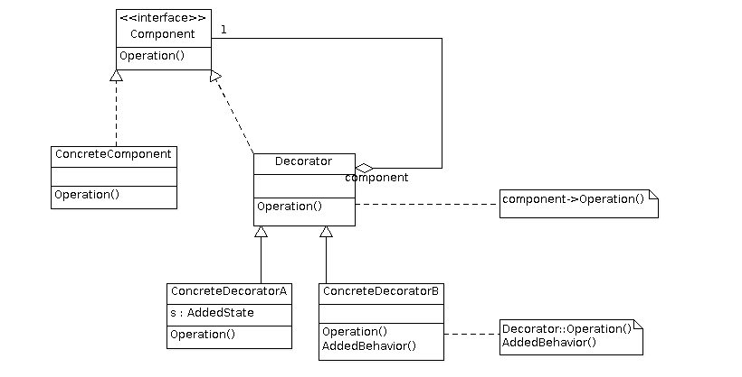
Decorator Solution
abstract class or
interface ?
?

Slide 18
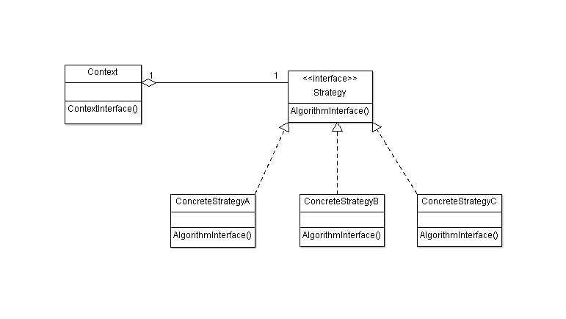
Design principle
Favor aggregation over inheritance

Slide 19
Decorator consequences
+ More flexibility than static inheritance
+ Avoids feature-laden classes high up in the hierarchy
- Lots of little objects
- Danger of duplicated code
abstract class Beverage
{
boolean hasMilk;
boolean hasSoy;
boolean hasWhip;
String getDescription();
double cost()
{ // returns condiment cost
double cost = 0.0;
if (hasMilk) cost += milkCost;
...
return (cost);
}
}
class HouseBlend extends Beverage
{
double cost() { return (1.99 + super.cost()); }
}

Slide 20

Decorator assignment
Apply the Decorator pattern

